Slide 2
Look for a character and take a good selfie!
Leticia Barrionuevo
Luis I. Martínez

Slide 3
First Library Week

Slide 6
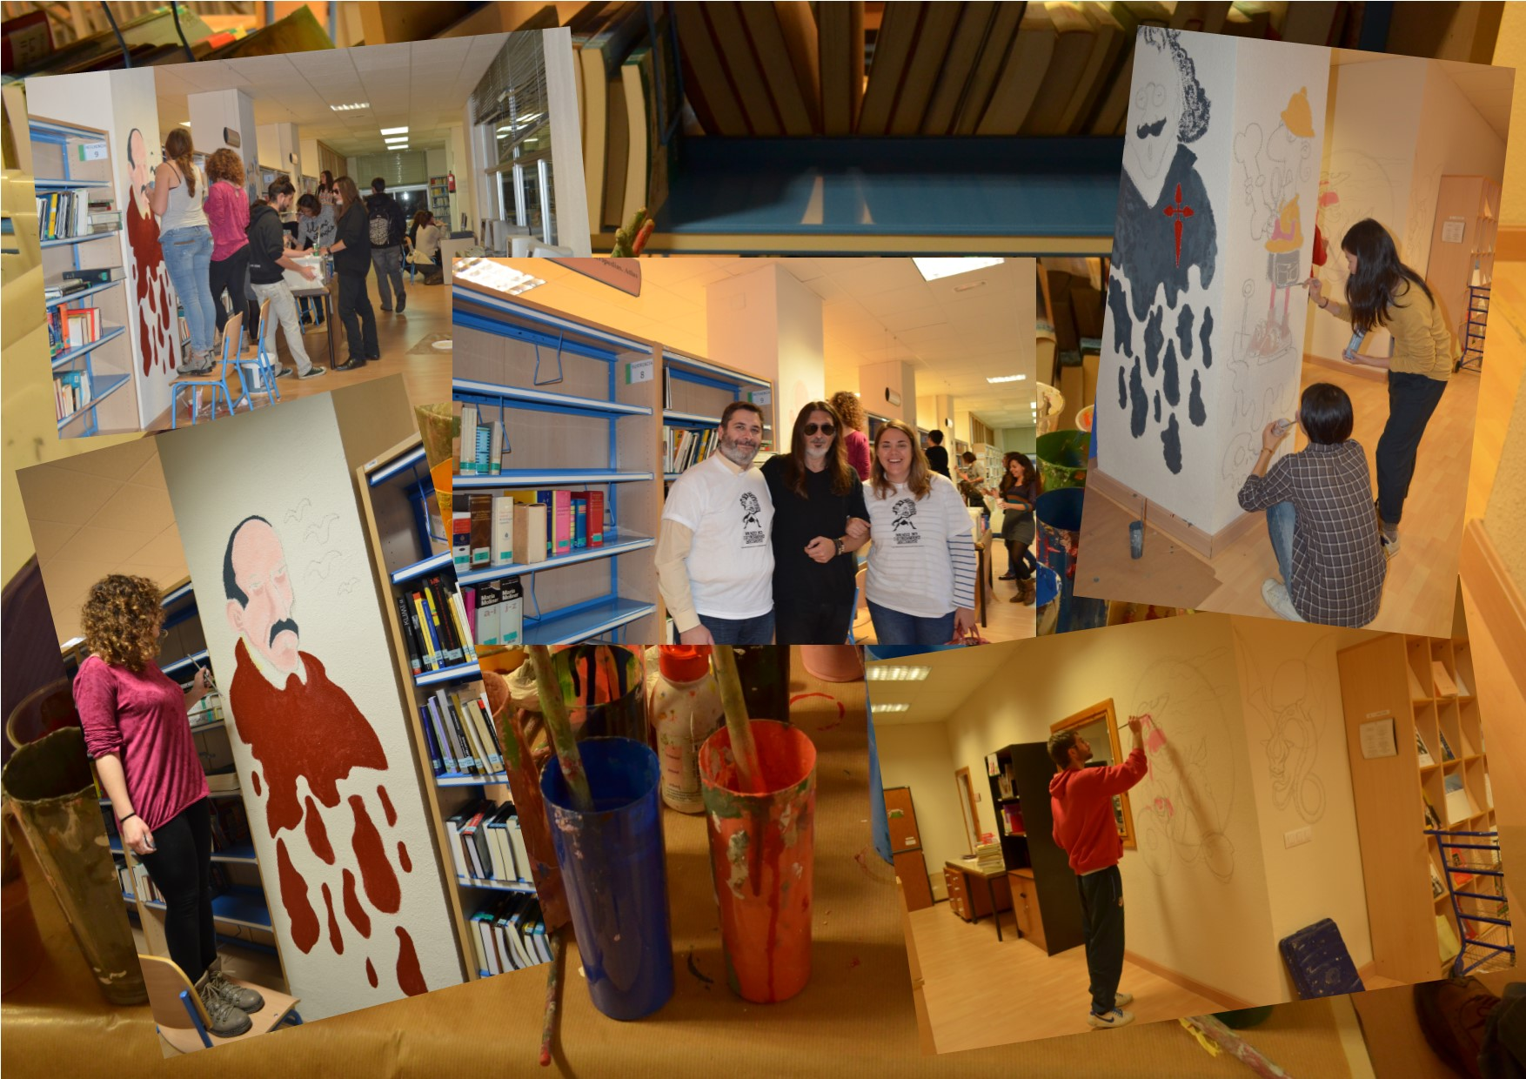

Slide 8
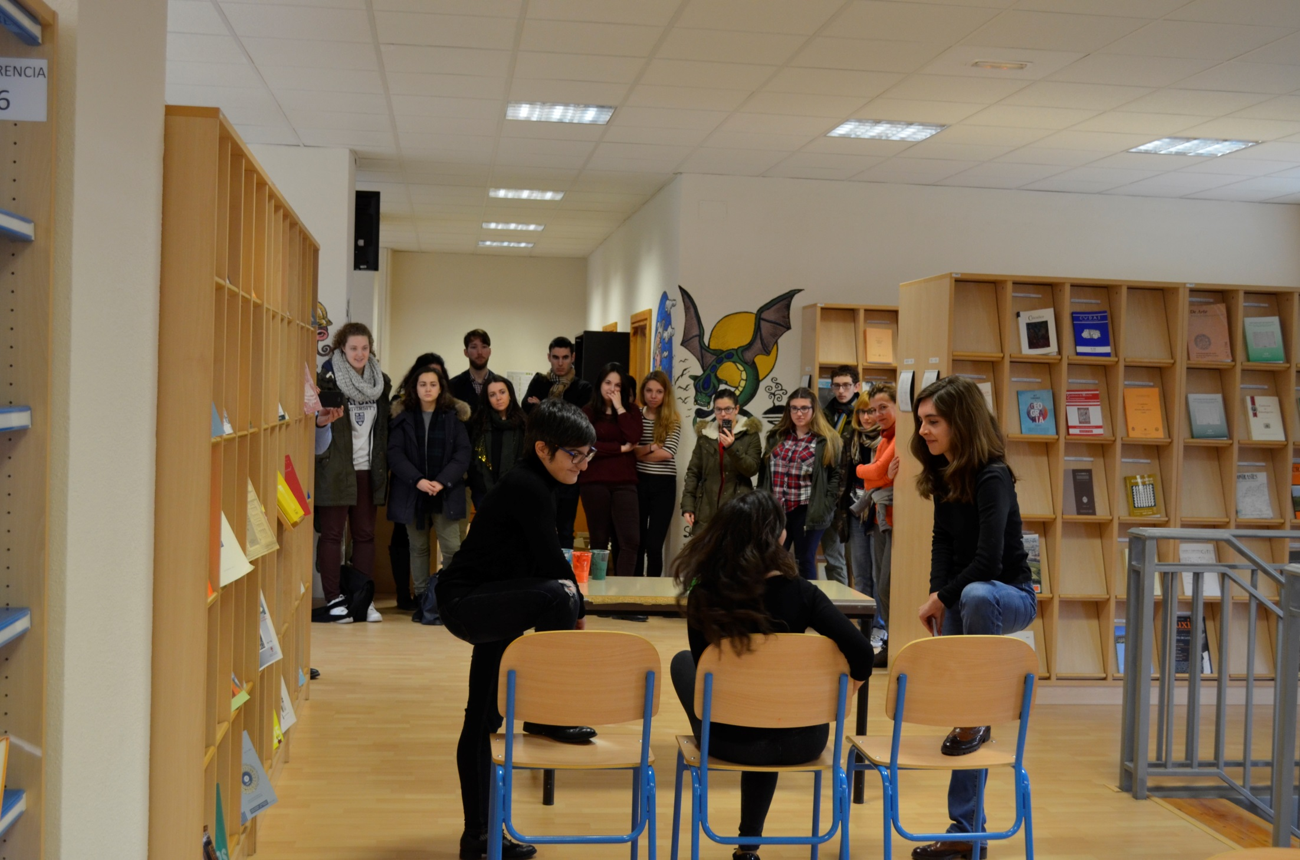

Slide 9
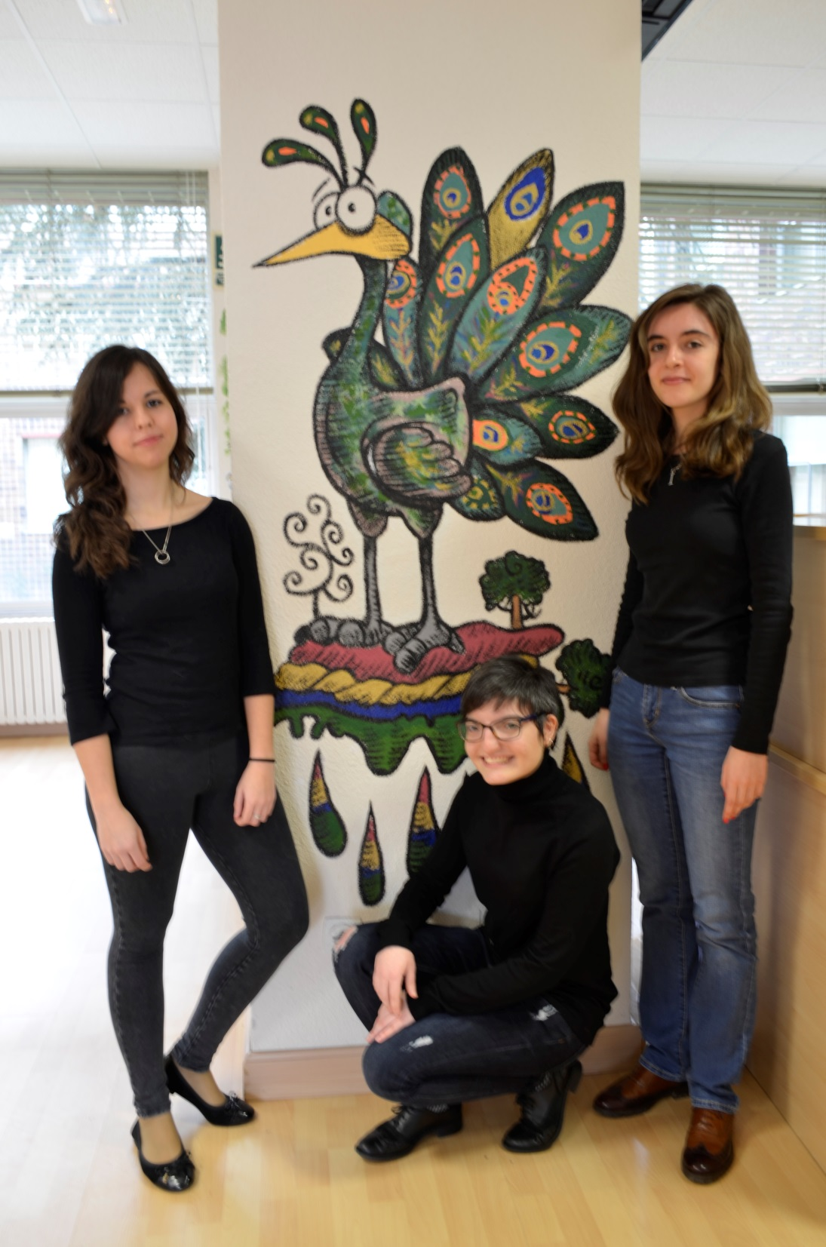

Slide 10
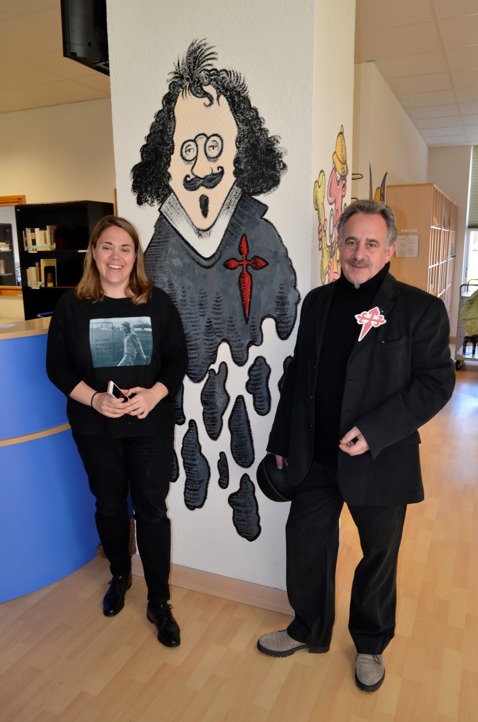

Slide 11
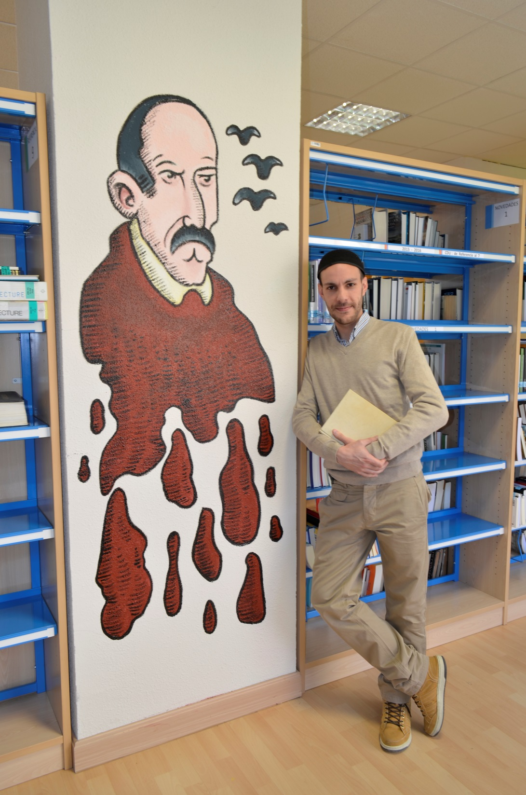

Slide 12
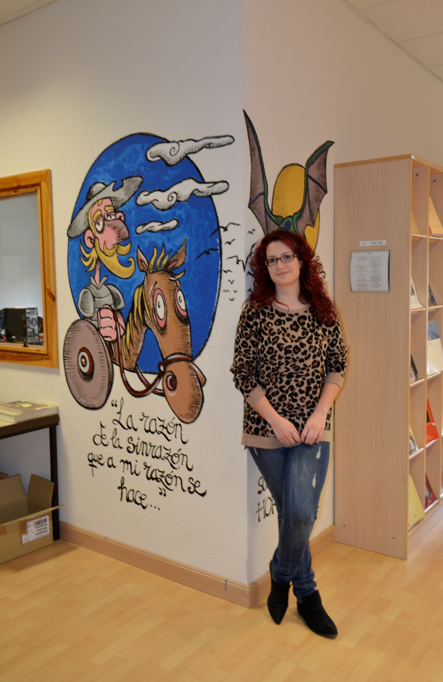

Slide 13
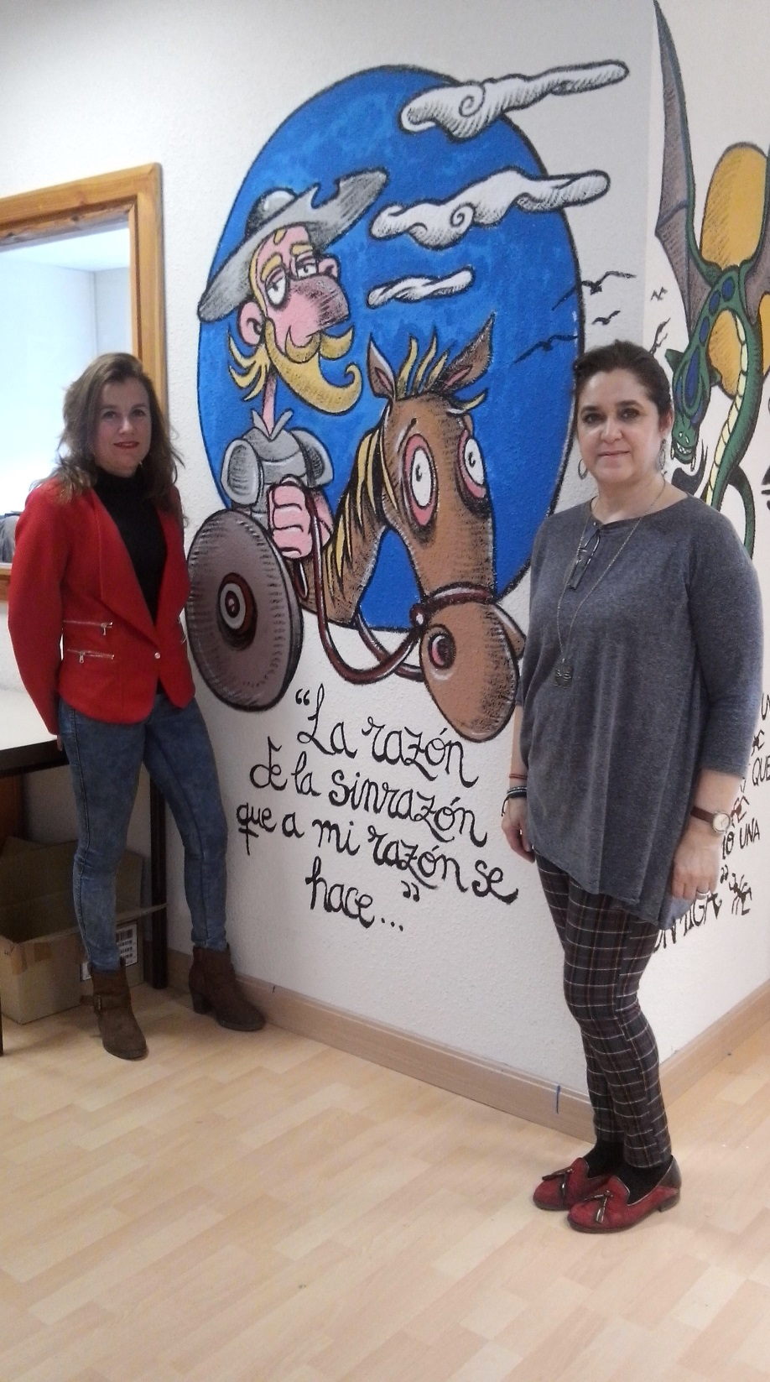

Slide 14
Diffusion

Slide 17
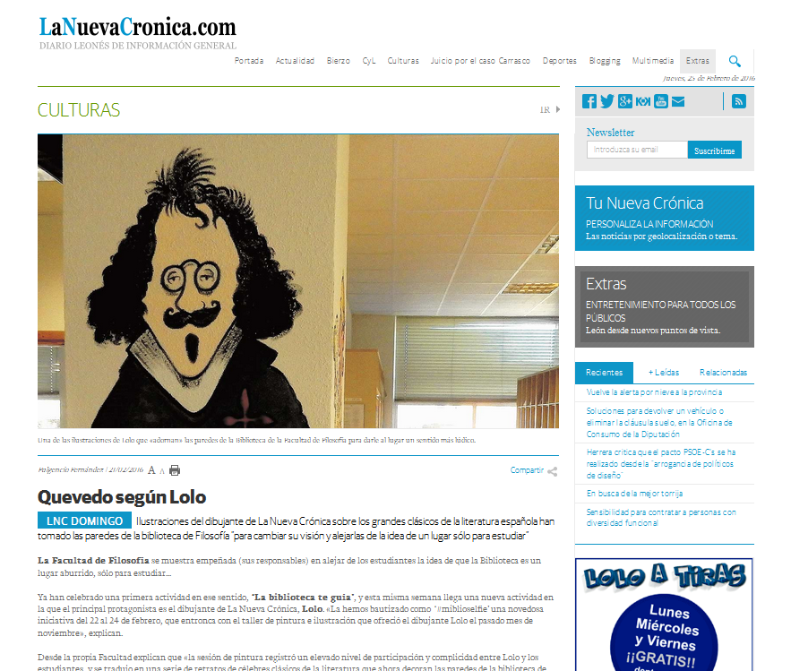

Slide 19
Thank you
Leticia Barrionuevo
buffl@unileon.es
Luis I Martínez
bulmc@unileon.es

